Slide 1
Car Price Prediction Model
By: Mohammad Shahid & Marcelo Enriquez

Slide 2
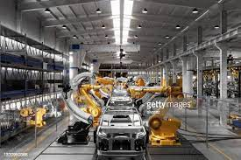
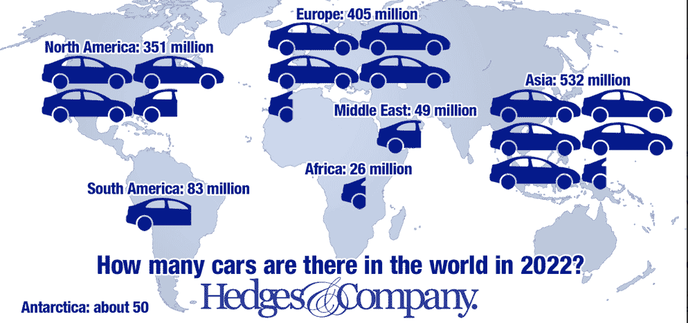
Introduction

Slide 3
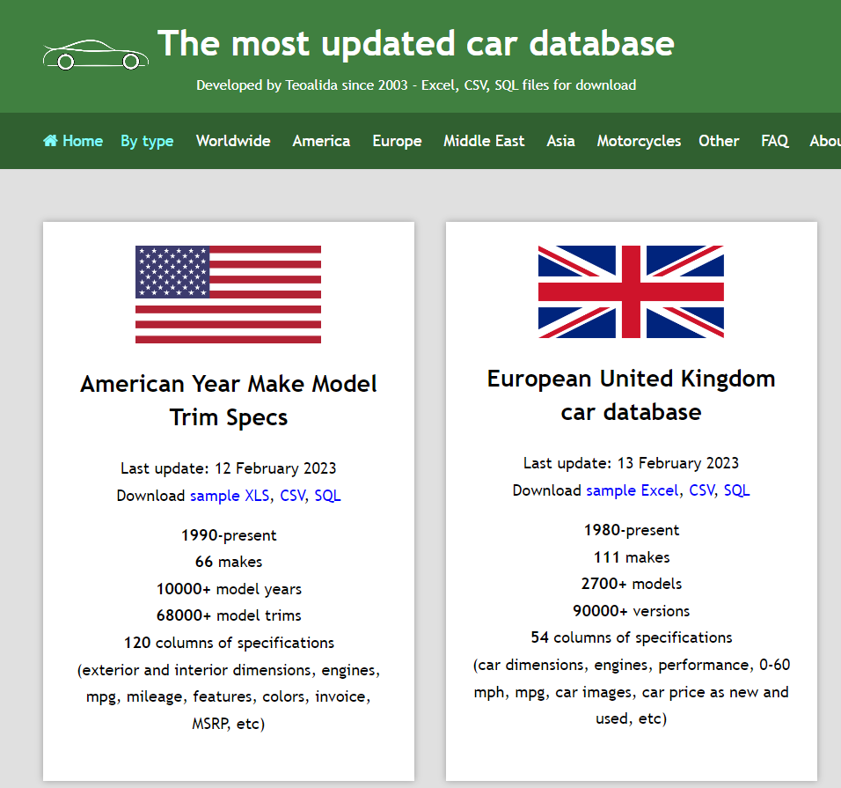
Data Collection

Slide 4
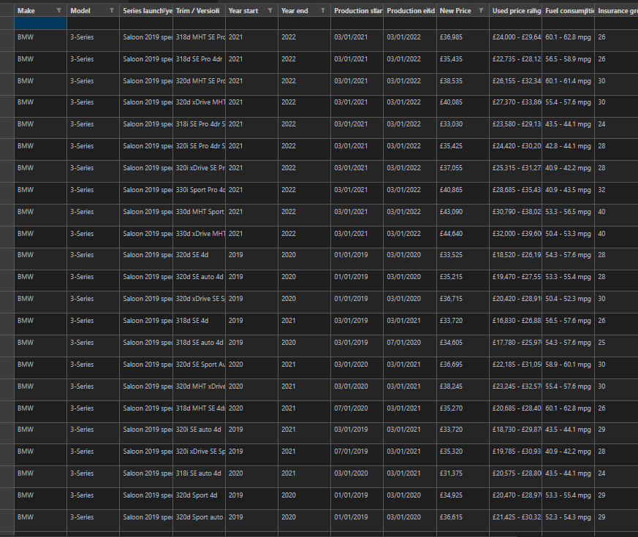
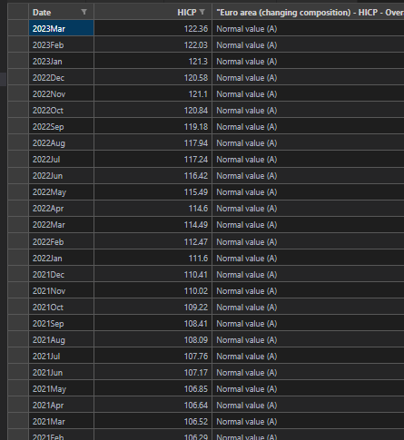
Data Sources
The first data source we decide to use is called “dataset.csv”
Contains: 3200 rows × 54 columns of car data
The data set includes variables such as make, model, year, horsepower, and fuel type.
The second data source we decided to use is called “inflation.csv”
Contains: 315 rows x 5 columns of car inflation data
The data set includes variables such as date, HCIP, Euro area (changing composition)

Slide 5
Data Processing
Data processing is done through the cardata.py that is in the data folder in our project.
In the case of the car database, the data cleaning process had numerous revisions as the project developed. The start of preprocessing was filling any null values with 0. and removing characters such as “-” from the data and replacing them with 0, This would allow the columns to be used and manipulated.
We then had to update the price columns, removing the British pound symbol for new data creation and manipulation. Additionally, certain columns needed to be updated as they were given in a range, our solution was to get the mean of the range replace the range with that updated value.
Before Data Processing
After Data Processing

Slide 6
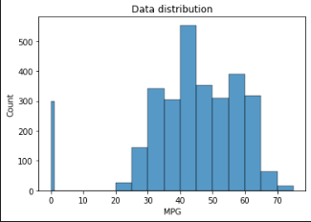
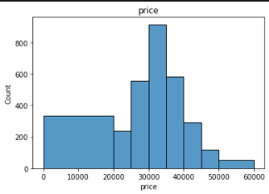
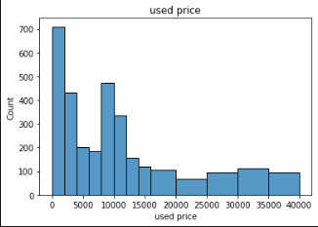
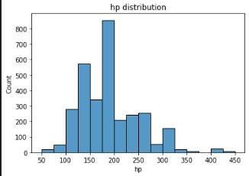
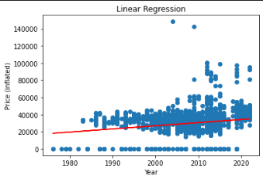
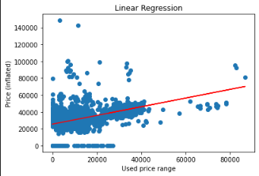
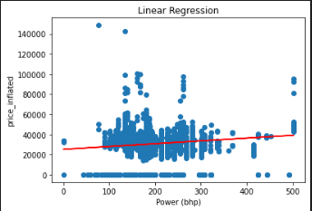
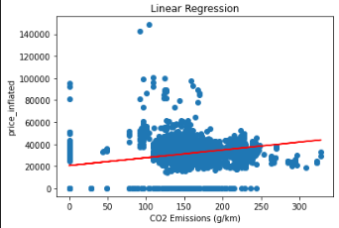
Data Visualization
In order to help us with our data, we created a few visuals to help us understand our data.

Slide 7
Feature Selection
Feature selection is the process of identifying the most relevant variables or features for the machine learning model
Feature selection is important because it helps to reduce the complexity of the model, and it can improve the model's performance by reducing the risk of overfitting.
In the case of the car database, we could perform feature selection by analyzing the correlation between the variables and the target variable (such as the price of the car), and selecting the most highly correlated variables.

Slide 8
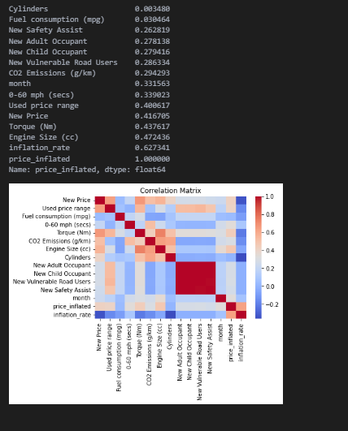
Feature Selection
Correlation Analysis:
A correlation value ranges from -1 to 1, where -1 indicates a perfect negative correlation, 0 indicates no correlation, and 1 indicates a perfect positive correlation. As you can see from the data we have gathered, cylinders and fuel consumption are towards the bottom compared to inflation_rate and engine size.

Slide 9
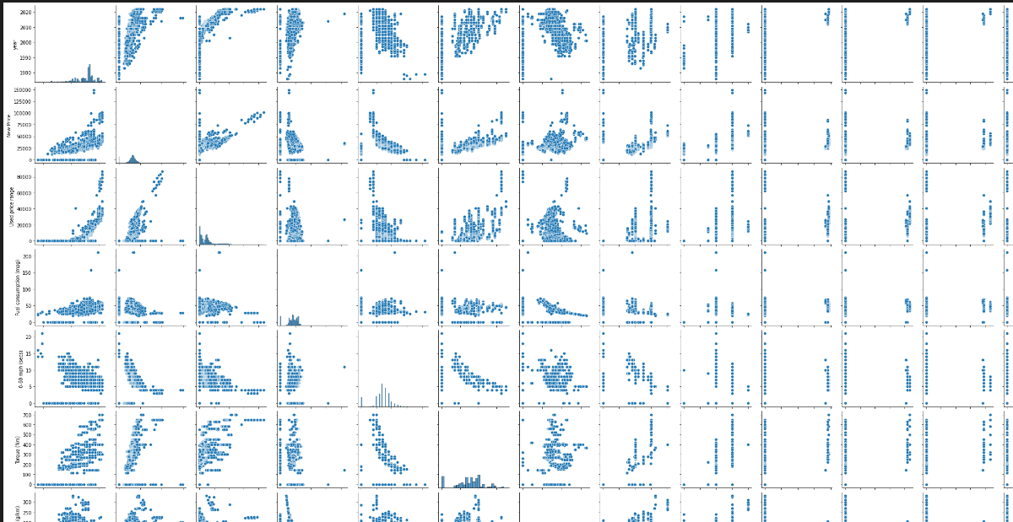
Feature Selection
Pair plots were used to help us identify the relationship between each feature and the target variable. Non-linear relationships that we could not see from the correlation matrix alone.

Slide 10
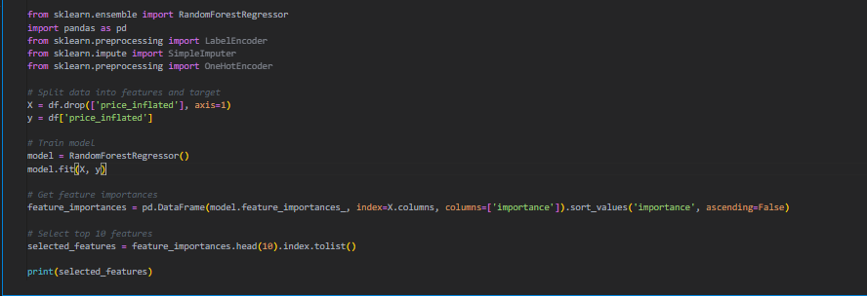
Feature Selection
We created a feature selection code where it takes the top 10 important features from the processed dataset.csv
The result: ['inflation_rate', 'Insurance group', 'Length (mm)', 'Engine Size (cc)', 'Used price range', 'New Price', 'Height (mm)', 'year', 'Power (bhp)', 'CO2 Emissions (g/km)']

Slide 11
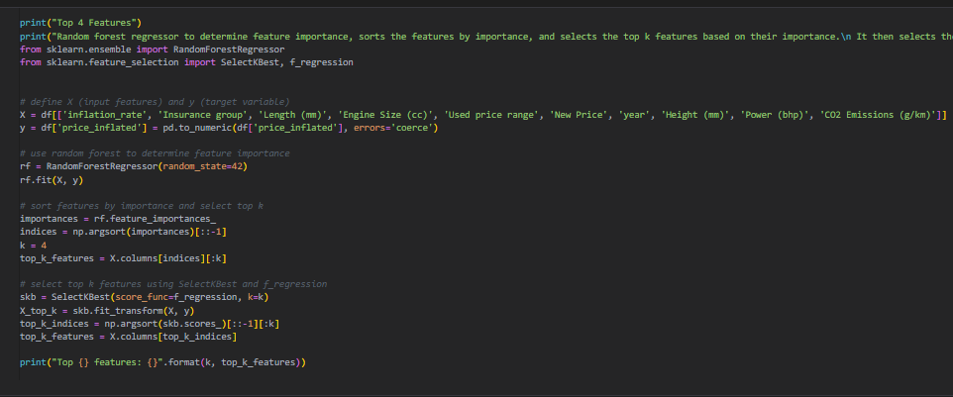
Feature Selection
We obtained the top 10 important features from the code in the previous slide.
With the results, we use random forest regressor to determine feature importance, sorts the features by importance, and selects the top k features based on their importance. It then selects the top k features using the SelectKBest function and f_regression score function. In this case, we will choose 4 features that are good out of the result we got previously
The results we get: (['inflation_rate', 'Insurance group', 'Length (mm)', 'Engine Size (cc)']

Slide 12
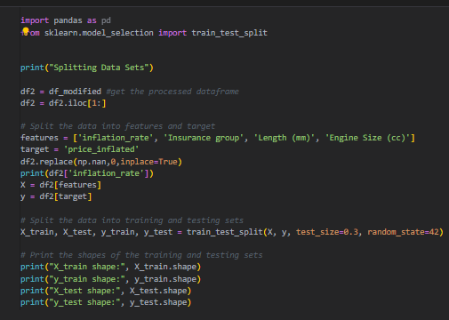
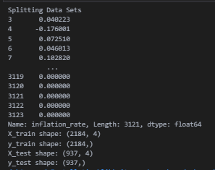
Train-Test Split
In the case of the car database, we could randomly split the data set into a training set (e.g., 80% of the data) and a testing set (e.g., 20% of the data) to train and evaluate the performance of the machine learning model on the data set.
As you can see, we are using the top 4 features we got.

Slide 13
Model Building

Slide 14
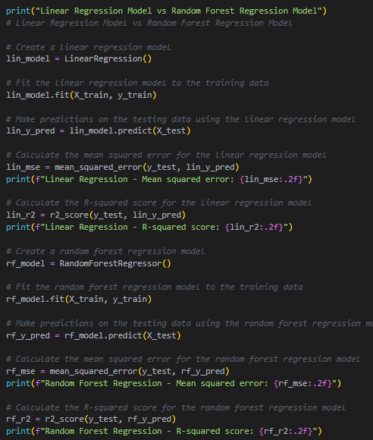
Linear Regression vs Random Forest Regressor Model
We decided to compare the two models Linear Regression and Random Forest Regressor Model with the dataset that was processed.

Slide 15
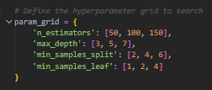

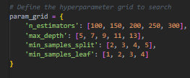
Hyperparameter
Tuning
Hyperparameter #1
We decided to test 3 Hyperparameters to see if it’ll increase our R Squared Score on the Random Regressor Model.
We tuned the hyperparameters of the model using Gridsearch
Hyperparameter #2
Hyperparameter #3

Slide 16
Sample Size Testing
Furthermore, we changed up the test_size to see if we would get a significant increase in R square score. However, the higher the test_size, the more overfitting occurs to our result.
We decided to go with 0.3 as our test_size

Slide 17
Results

Slide 18

Results
When performing Performance Metrics, we also decided to include Ridge Regularization in order to see the models score after applying the regularization
Ridge regularization is a technique that adds a penalty term to the regression coefficients to prevent overfitting. In your case, the R-squared score with Ridge regularization is 0.74 (+/- 0.09), which suggests that the model's performance has improved somewhat after applying regularization.

Slide 19
Results
Overall Results:
The R-squared score of the linear regression model was 0.68, while that of the random forest regression model was 0.89
The results indicate that the random forest regression model outperformed the linear regression model in terms of mean squared error and R-squared score.

Slide 20



Results
Hypertuning Parameter Results:
Since we tested 3 different hyperparameters, the results were quite surprising
The hyperparameters compared to the model without the tuning, the one without the tuning performed better.

Slide 21
Logical Partitioning

Slide 22
Logical Partitioning
For the tasks that we were given, we split it up 50/50. Mohammad worked on the models and the feature selection. Marcelo worked on data processing and visualization. Furthermore, whenever we needed help in certain parts, one would come in and start working on the others part. For example, if Marcelo needed help with data processing/visualization, Mohammad would come in and start helping, same with if Mohammad needed help with the models, Marcelo would start helping.

Slide 23
Conclusion

Slide 24
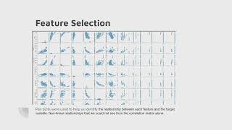
Video

